Slide 1
ATAI
Advanced Techniqueof Artificial Intelligence
ATAI
ChongqingUniversity _{AdvancedTechniqueof}
of Technology Artificial Intelligence
Chongqing University of
Technology
Chongqing University ^{ATAI}
_{of Technology} Advanced Techniqueof
Artificial Intelligence
Chongqing University of Technology
Chongqing University of Technology
Learning Language-guided Adaptive Hyper-modality Representation for Multimodal Sentiment Analysis
Code:None
2024.01.04 •ChongQing
—— EMNLP 2023
Reported by YaoChen Li
1

Slide 2
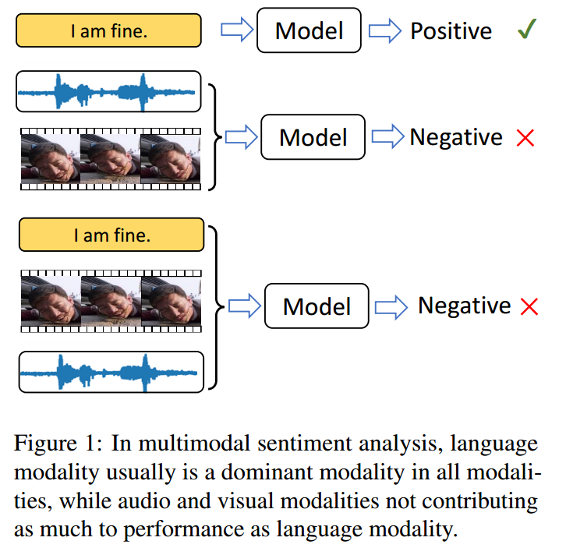
ATAI
AdvancedTechniqueof
Artificial Intelligence
ATAI
ChongqingUniversity _{AdvancedTechniqueof}
of Technology Artificial Intelligence
ChongqingUniversity of Technology
Motivation
(1) The potential sentiment-irrelevant and conflicting information across modalities may hinder the performance from being further improved.
(2) Information from different modalities may be ambiguous and conflicting due to sentiment-irrelevance, especially from non-dominating modalities (e.g., lighting and head pose in video and background noise in audio). Such disruptive information can greatly limit the performance of MSA methods

Slide 3
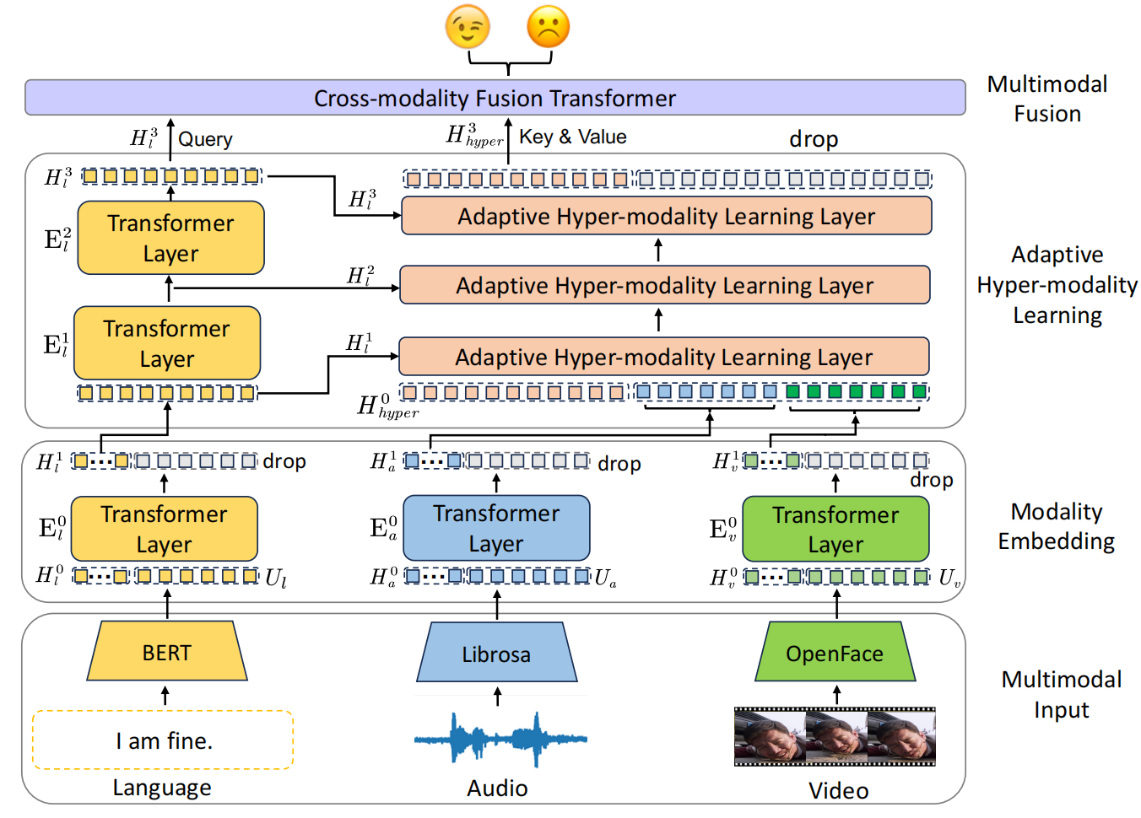
ChongqingUniversity of Technology
Overview
ATAI
AdvancedTechniqueof
Artificial Intelligence
ATAI
ChongqingUniversity _{AdvancedTechniqueof}
of Technology Artificial Intelligence

Slide 4
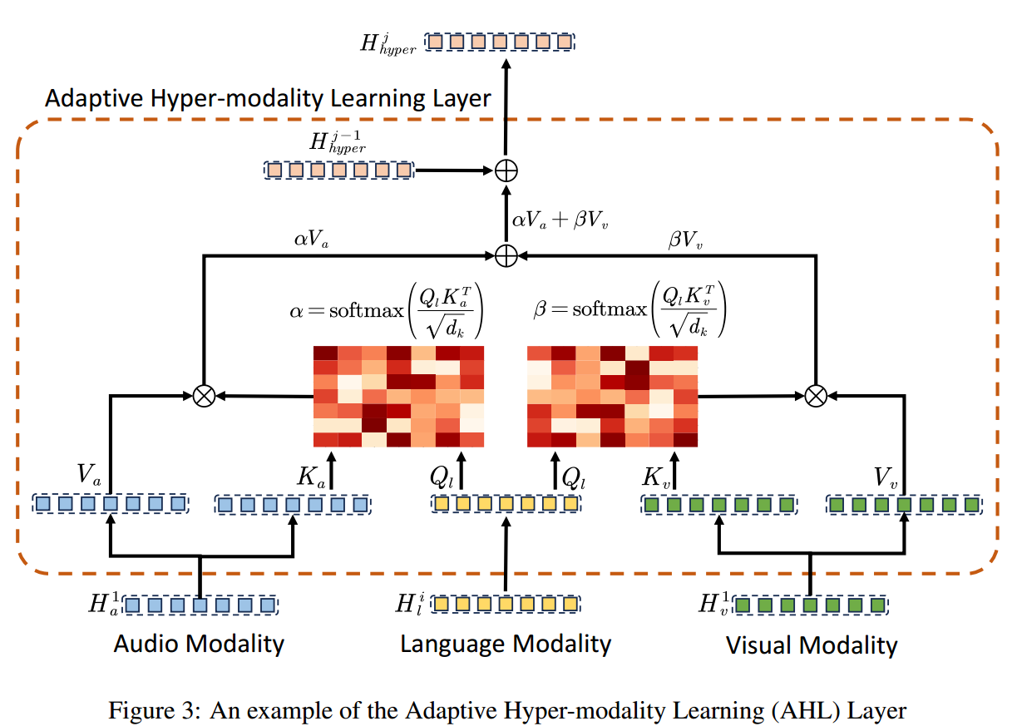
ChongqingUniversity of Technology
ATAI
AdvancedTechniqueof
Artificial Intelligence
ATAI
ChongqingUniversity _{AdvancedTechniqueof}
of Technology Artificial Intelligence
Overview

Slide 5
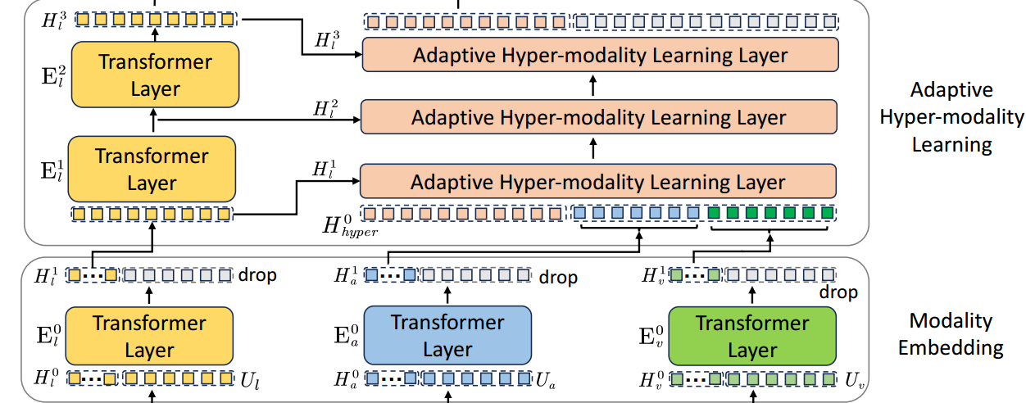
ChongqingUniversity of Technology
ATAI
AdvancedTechniqueof
Artificial Intelligence
ATAI
ChongqingUniversity _{AdvancedTechniqueof}
of Technology Artificial Intelligence
Method

Slide 6
ChongqingUniversity of Technology
ATAI
AdvancedTechniqueof
Artificial Intelligence
ATAI
ChongqingUniversity _{AdvancedTechniqueof}
of Technology Artificial Intelligence
Method

Slide 7
ChongqingUniversity of Technology
ATAI
AdvancedTechniqueof
Artificial Intelligence
ATAI
ChongqingUniversity _{AdvancedTechniqueof}
of Technology Artificial Intelligence
Method

Slide 8
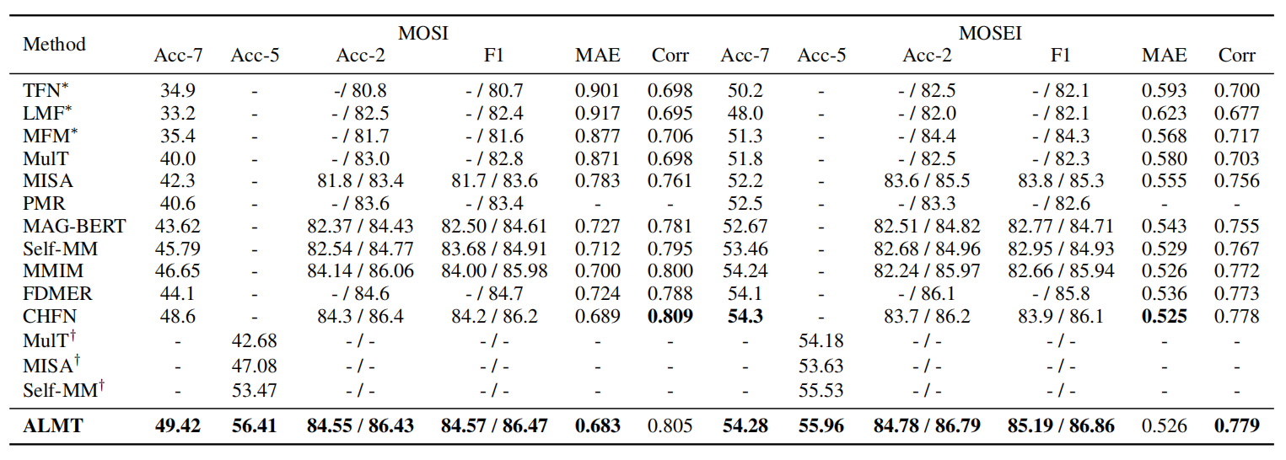
ATAI
AdvancedTechniqueof
Artificial Intelligence
ATAI
ChongqingUniversity _{AdvancedTechniqueof}
of Technology Artificial Intelligence
ChongqingUniversity of Technology
Experiments

Slide 9
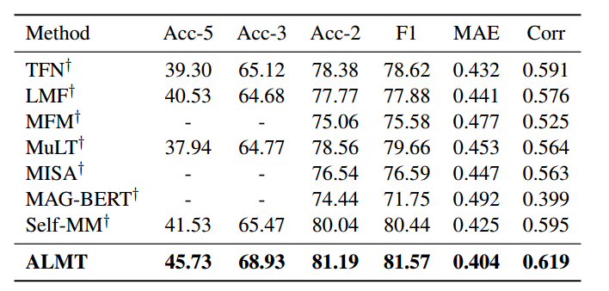
ATAI
AdvancedTechniqueof
Artificial Intelligence
ATAI
ChongqingUniversity _{AdvancedTechniqueof}
of Technology Artificial Intelligence
ChongqingUniversity of Technology
Experiments
CH-SIMS

Slide 10
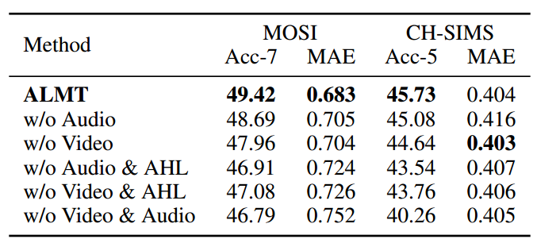
ChongqingUniversity of Technology
ATAI
AdvancedTechniqueof
Artificial Intelligence
ATAI
ChongqingUniversity _{AdvancedTechniqueof}
of Technology Artificial Intelligence
Experiments

Slide 11
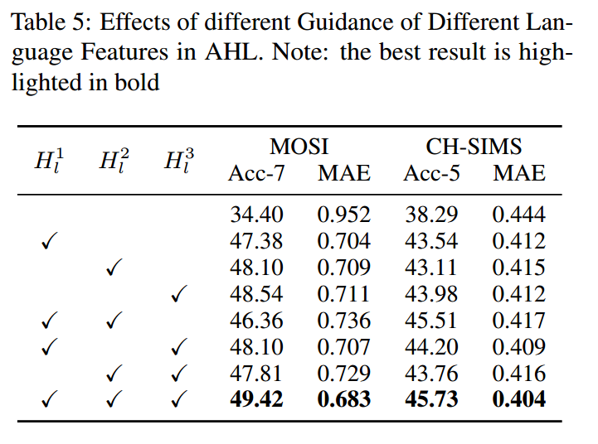
ChongqingUniversity of Technology
ATAI
AdvancedTechniqueof
Artificial Intelligence
ATAI
ChongqingUniversity _{AdvancedTechniqueof}
of Technology Artificial Intelligence
Experiments

Slide 12
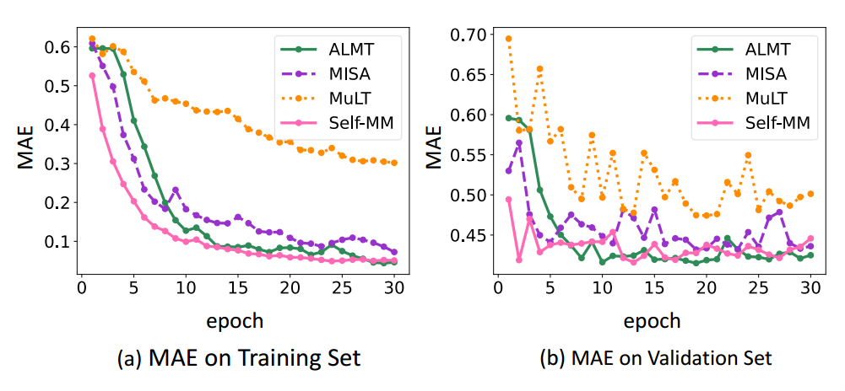
ChongqingUniversity of Technology
ATAI
AdvancedTechniqueof
Artificial Intelligence
ATAI
ChongqingUniversity _{AdvancedTechniqueof}
of Technology Artificial Intelligence
Experiments
Figure 4: Visualization of convergence performance on the train and validation sets of CH-SIMS. (a) The comparison of MAE curves on the training set; (b) the comparison of MAE curves on the validation set. Note: the results of other methods reproduced by authors from
open source code with default hyper-parameters

Slide 13
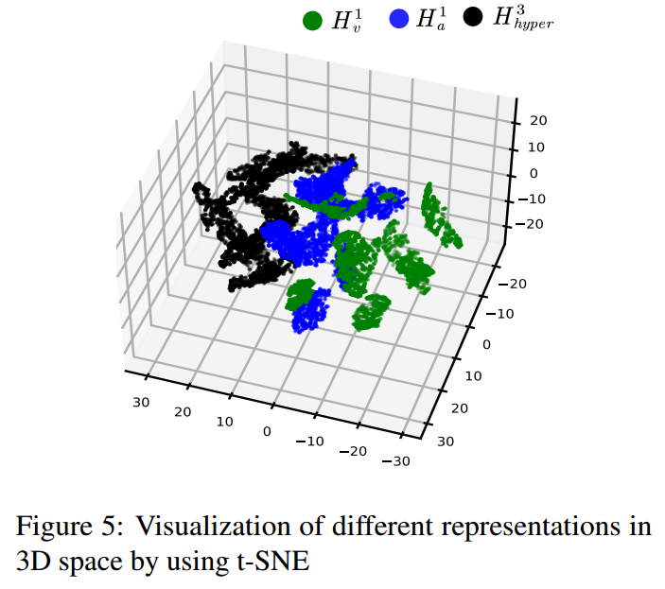
ChongqingUniversity of Technology
ATAI
AdvancedTechniqueof
Artificial Intelligence
ATAI
ChongqingUniversity _{AdvancedTechniqueof}
of Technology Artificial Intelligence
Experiments

Slide 14
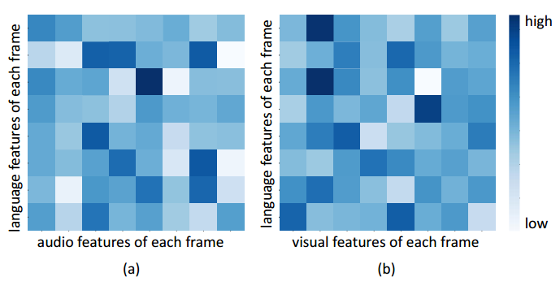
ChongqingUniversity of Technology
ATAI
AdvancedTechniqueof
Artificial Intelligence
ATAI
ChongqingUniversity _{AdvancedTechniqueof}
of Technology Artificial Intelligence
Experiments
Figure 6: Visualization of average attention weights from the last AHL layer on CH-SIMS dataset. (a) Average attention matrix α between language and audio modalities; (b) average attention matrix β between language and visual modalities. Note: darker colors indicate higher attention weights for learning.

Slide 15
ChongqingUniversity of Technology
ATAI
AdvancedTechniqueof
Artificial Intelligence
ATAI
ChongqingUniversity _{AdvancedTechniqueof}
of Technology Artificial Intelligence
Thanks!

